Slide 1

IBM Data Science Capstone
Accident Severity Prediction

Slide 2
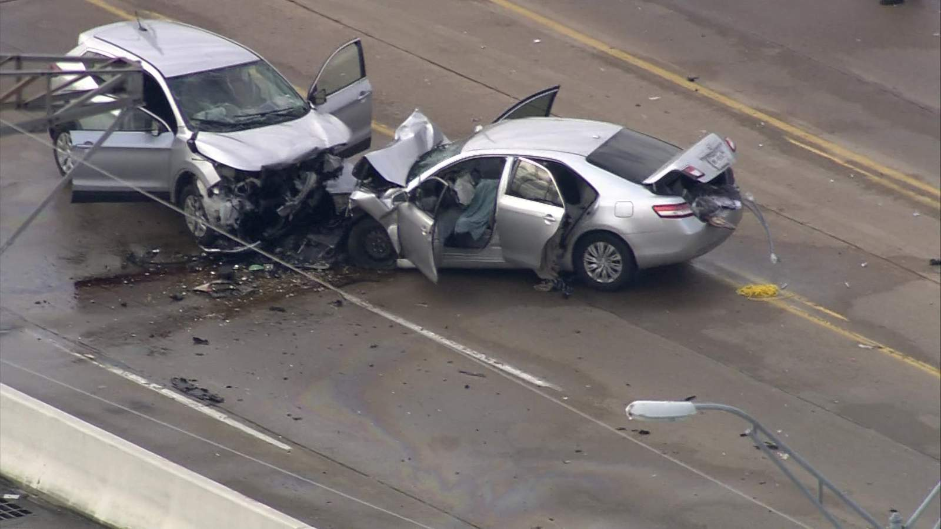
Introduction
Why?
Detrimental impact of accidents on both human and physical capital
Imperative to understand this data set
and put some statistics based computational efforts towards minimizing the incidence of these accidents.
What?
The underlying objective of using and understanding this data set is to use historical accident data and find out what conditions usually lead these accidents.
Who?
Will benefit any car manufacturer looking to develop alarms for drivers based on the findings that will emphasize the conditions under which accidents are most probable.

Slide 3
Data
How?
The data set consists of all collisions provided by the Seattle Police Department and recorded by Traffic Records.
Includes all types of collisions.
Time frame of the data collected is from 2004 to present.
Data broadly covers the time, place and conditions under which these collisions took place. The severity code is described as follows:
3 — Fatality
2b — Serious injury
2 — Injury
1 — Property damage
0 — Unknown

